Slide 1
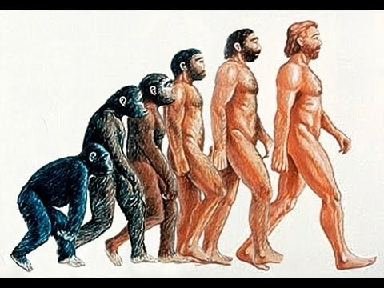
The Early Man
The early human looked more or less like apes
Gradually they learnt to walk straight
Gradual process in which something changes into a different and better form is called evolution

Slide 2
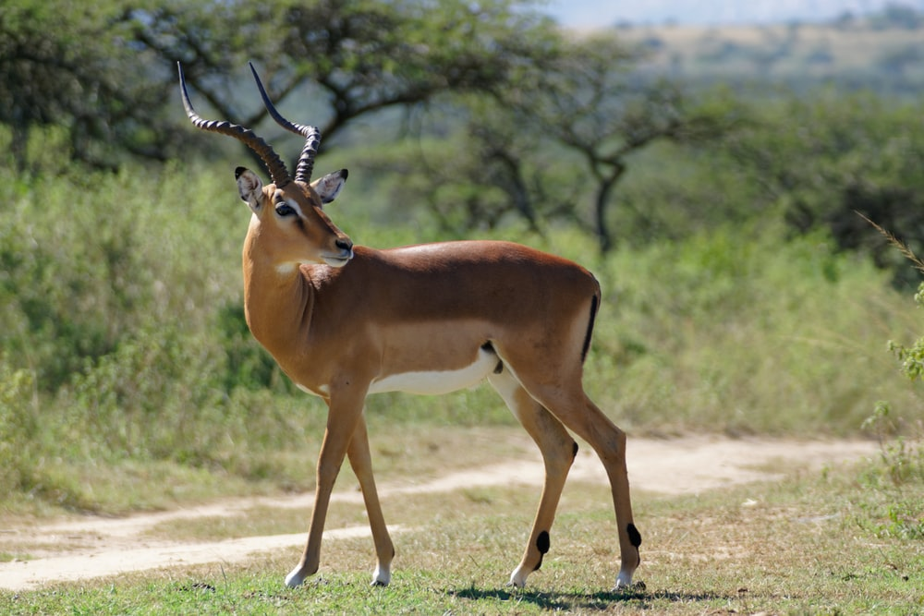
Food
Early man is also called primitive man
They did not know how to grow food
They used to dig the ground and eat the roots of plants
They gathered fruits from the forests
They hunted animals like deer and antelope and ate their flesh

Slide 3
Shelter
Early man lived in forests and took shelter under trees and in caves
These caves protect them from wild animals and different weather conditions.

Slide 4
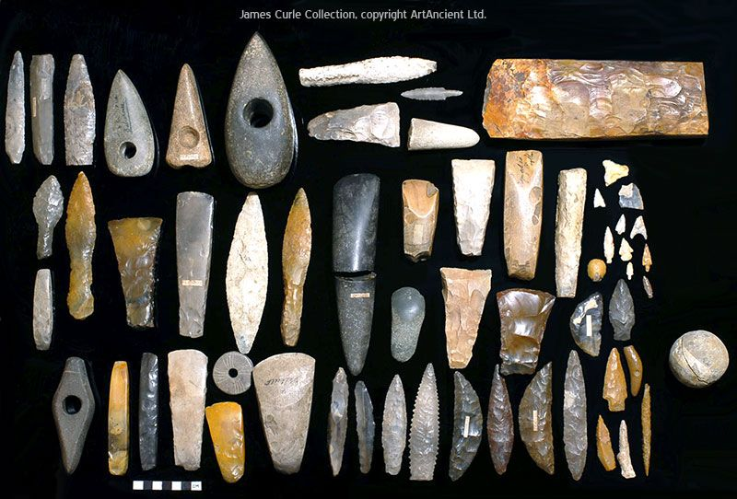
Tools
It was very difficult for early man to use his hands to dig the ground or to kill animals.
So, the started using stones
When they found sharp stones, they chipped them and shaped into tools to hunt animals or to cut wood
These tools were mainly used for:
Cutting meat and animal bones
Peeling off animal skins or hides and barks from trees
Making spears and arrows for hunting
Digging ground to take out roots.

Slide 5
Use of fire
Early man discovered fire by chance.
While using stones to make tools, he rubbed two stones together which produced a spark.
Some dry twigs caught fire from these sparks. Thus, early man learnt how to make fire from stones.
He used fire as a protection from wild animals.
The warmth from fire also protected him from cold.
When a piece of flesh was roasted on fire it tasted better.
He found that roasted food was softer and tastier.
They learnt t use fire for cooking.

Slide 6
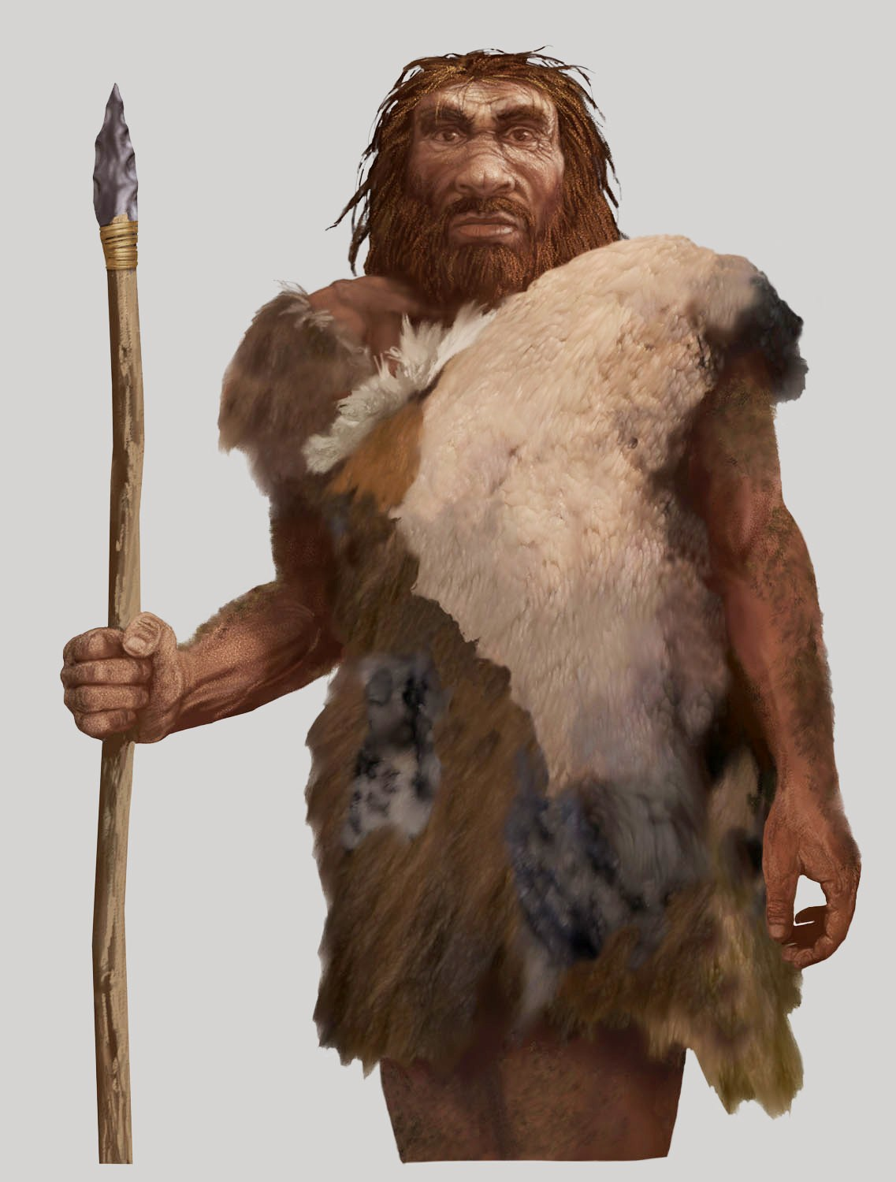
Clothes
Primitive man had very limited needs.
He gathered food only when he felt hungry.
He covered his body to protect himself from rain and cold.
He wore hide of dead animals
He also wore leaves and barks of trees.

Slide 7
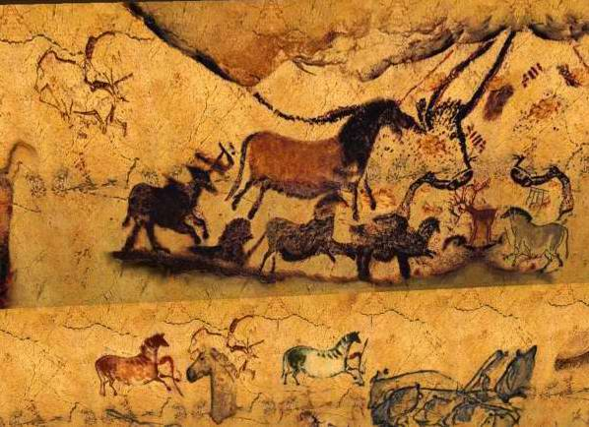
Art of Early man
When early man started living in caves, they began drawing on the walls and ceilings of the caves.
The drawings gradually turned into beautiful paintings and sculptures.
They drew figures of wild animals
Drawings were also used to express his feelings and to send messages.

